Slide 1
The Spread of Behavior in an Online Social Network Experiment (2010)
By Damon Centola
Discussed by:
Mirza Kashif
Tahaa Imtiaz
Muhammad Usman
Anas Abid

Slide 2
Road Map
Motivation
Data
Introduction
Methodology
Experiment
Findings
Strengths
Caveats

Slide 3
Motivation
To investigate the effects of network structure on diffusion of behaviors by studying the spread of health behaviors through artificially structured online communities
Observe the effects of social signals on adoption of behavior

Slide 4
Data
The study was run for a 124-day period
1,528 subjects participated in the study
Subjects were recruited through email advertisements

Slide 5
Introduction
Study carried out by Damon Centola on the diffusion of behaviors spread through different network types
The two types of networks that were focused upon in this paper were Clustered Lattice Network and Random Network
Explore all factors that can impact the diffusion of behavior in these networks
Produce statistical data to support the study through experimentation

Slide 6
Introduction
Impact of social reinforcement on the various types of networks
Two hypotheses discussed in the article
  Strength of weak ties
    how it is able to spread a social health behavior farther and quicker than a network that is highly clustered
  Importance of reinforcement for the adaptation of behavior
    Unlike information/behavior such as diseases, social behavior is a different form of behavior

Slide 7
Methodology
Test the effect of network
Two types of network were formed
Every node of network had same number of neighbors
Pattern of connectivity in social network was different

Slide 8
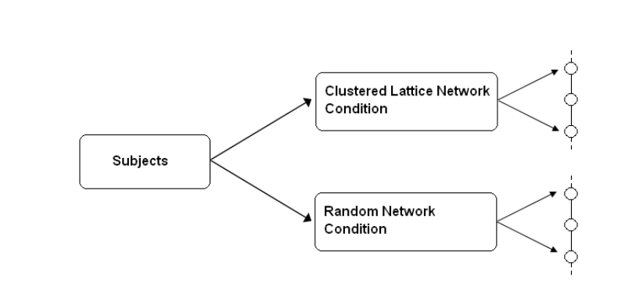
Experiment
each trial of the study consisted of a pair of networks
one of each condition – a clustered lattice network condition and a random network condition
the only difference between conditions was the topological structure of the ties that connected the participants.

Slide 9
Experiment
Six independent trials of the study were run.
Across all six trials, 50% of subjects were enrolled in the clustered lattice network condition and 50% were enrolled in the random network condition.
Social signals were given to the analyze the effect of signals on adoption.

Slide 10
Findings
The researcher finds that structure of the network has an important effect on the effect of adoption of a behavior.
Adoption rate was quicker in clustered and bigger groups than in random circles.
Rate of adoption in clustered networks was four times faster than random circles.
On an individual level the author finds that larger the number of health buddies each person had the faster they adopted a behavior.

Slide 11
Findings
It was found that after receiving a second signal, adoption increased and after a third signal the adoption rate increased significantly but the marginal effect was small.
The author finds that 15% of the individuals who received one signal made a return visit and 30% of the individuals who received two signals made a return visit and 40% of the individuals who received 3 signals made at least one return visit.

Slide 12
Strengths
This research will facilitate and help future researchers and Educational Institution
Participants randomly assigned one of two experimental design
Overcame the weakness of observation
Help Interventions by authorities implement better health strategy
Notes:
1)This research will facilitate and help future researchers and Educational Institution in improvising and implementing the programs more efficiently
2)Participants in the experiment were randomly assigned one of the two experimental conditions to avoid biasness.
3)Damon could have done this through observation as well but this experimental design allowed him to over come the weaknesses of observation the weakness mentioned in the article we quite complex
4) This research could help Interventions by authorities implement a health strategy better and efficiently.

Slide 13
Caveats
Adoption is also affected by the level of commitment towards a behavior
Diffusion of real world health behavior maybe based on clustered networks
Only spread of good behavior was analyzed
in on-line experiments, researchers have less control over the behavior of the subjects.
Notes:
A concern raised by the author is that adoption is also affected by the level of commitment towards a behavior, regarding this he states that behaviors come with a cost that be stated as opportunity cost such as time deprivation, physical pain etc.
diffusion of real-world health behaviors may depend even more on clustered network structures than did the diffusion dynamics reported by the the author
Only spread of good behavior was analyzed
in on-line experiments, researchers have less control over the behavior of the subjects.

Slide 14
Caveats
a single observation for each individual
The weaknesses were quite complex
subjects could encourage peers to sign up for the study
Limited number of participants
Age Group not mentioned as adoption might be different across age groups
Notes:
a single observation for each individual
The weaknesses were quite complex as well as the jargon
possible that subjects could encourage peers to sign up for the study in order to get access to the health forum
Limited number of participants as there were only 1528
Participants in the experiment were randomly assigned one of the two experimental conditions to avoid biasness.

